Slide 1

Health Risk Predictor And Food Nutrition Checker
Of
BACHALORE OF TECHNOLOGY
In
COMPUTER SCIENCE ENGINEERING
By
Kashif Akhter – 21105125011
Sumit Kumar – 21105125004
Anuj Kumar – 21105125006
Syed Tabish Ahmad – 21105125019
Under the guidance of
Prof. Rohit Kumar
(Asst. Professor)
DEPARTMENT OF COMPUTER SCIENCE AND ENGINEERING
RASHTRAKAVI RAMDHARI SINGH DINKAR COLLEGE OF ENGINEERING, BEGUSARAI, BIHAR - 851134

Slide 2
Problem Statement
In the modern era, unhealthy eating habits and sedentary lifestyles have led to a rise in nutrition-related health problems such as obesity, diabetes, and heart diseases. Despite the availability of food information, people lack tools that combine personal dietary intake with predictive health alerts.
This project aims to bridge that gap by offering a personalized nutrition tracker with ML-based health risk analysis.

Slide 3
Objective:
To allow users to enter their dietary, personal, lifestyle data like (Calories, Carbs, Protein, Fat, Sodium, Eating Habit, Activity level, Age, Weight, Height).
To calculate calorie and macronutrient intake according to input dynamically.
To use machine learning to predict potential health risks.
To provide a searchable food database with nutritional details help to make correct input of macronutrient intake.
To raise awareness of daily nutrient balance and healthy diets.

Slide 4
Dataset Used
The project uses two main datasets:
*Food Nutrition Dataset: Contains food items and their nutritional values (Calories, Carbs, Protein, Fat, Sodium, etc.).
**User Health Dataset: Includes age, height, weight, activity level, diet type, and dietary intake features along with health condition labels.
The ML model was trained on the second dataset to identify correlations between nutrition and diseases.
*Dataset created by our Team Members.
**Online available dataset from internet.

Slide 5
Technology Stack
Frontend
Streamlit – for building interactive web-based UI
Backend
Python
Pandas and Numpy for data handling, Matplotlib for graphs.
Machine Learning:
Scikit-learn for training and prediction
joblib for model saving/loading.
Storage
CSV files for food dataset and serialized models for prediction

Slide 6
Overall Architecture
User inputs age, height, weight, diet type, activity level, and nutrient intake.
Calories are dynamically calculated.
Data is scaled using a pre-fitted transformer.
The transformed data is passed to a trained ML model.
Predicted health conditions (if any) are displayed along with visual nutrient summary.
Food Nutrition Checker module help to find out the nutrient summary of food items.

Slide 7
Model Training on ML Algorithms
The health risk prediction model was trained using various algorithms:
Logistic Regression
Random Forest Classifier
Support Vector Machine (SVM)
Gradient Boosting
Logistic Regression
K-neighbors Classifier
Decision Tree Classifier
Voting Classifier
AdaBoost Classifier
Gradient Boosting Classifier and more other ensemble learning
Evaluation Metrics: Accuracy, Precision, Recall, F1 Score
The best-performing model was saved using joblib.

Slide 8
Module 1: Health Risk Predictor
This module collects personal, lifestyle data and nutrient information:
Inputs: Age, Height, Weight, Activity, Diet, Protein, Sugar, Sodium, Carbs, Fat
Calories are auto-calculated
Data is passed to ML model for predicting risks like Diabetes, Obesity, Weight Gain, Hypertension, and Heart Disease.
Output: Risk labels shown with visual nutrient chart.

Slide 9
Module 2: Food Nutrition Check
This module lets users search for food items:
Uses a dataset of food items and nutrients
Searches by exact or partial food name
Displays nutritional information in table format
Educates users on healthier food choices

Slide 10
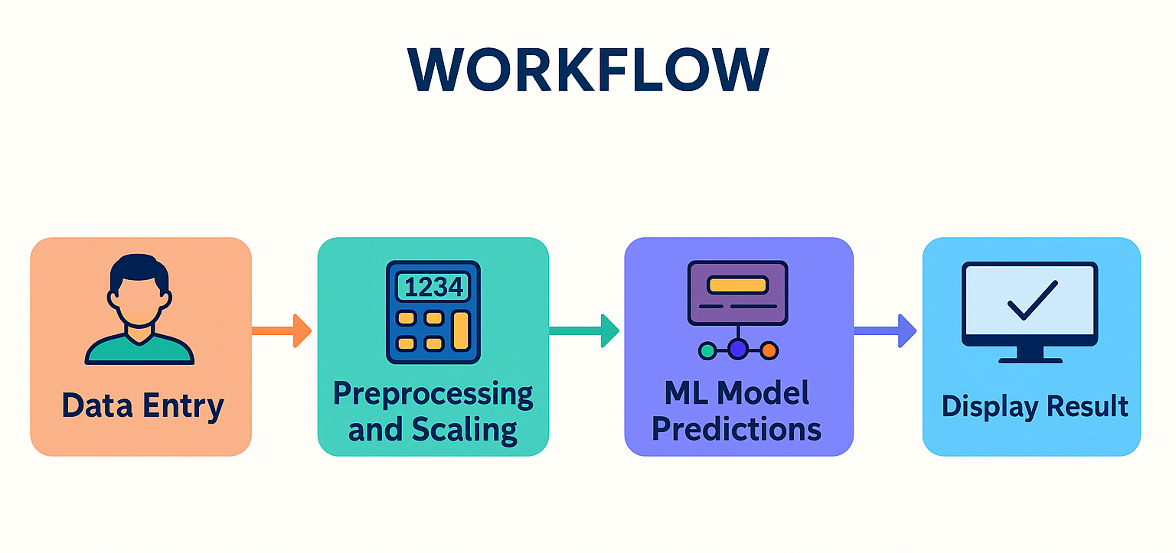
Model Workflow
Data Entry
Preprocessing & Scaling
ML Model Prediction
Output: Health risk labels (e.g., Diabetes)
All preprocessing and ML logic is encapsulated using joblib models to streamline predictions.

Slide 11
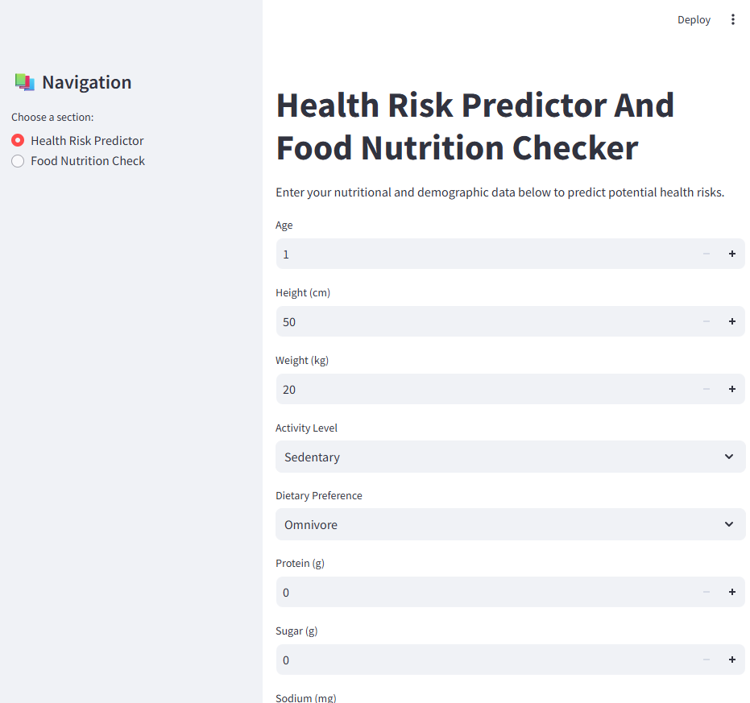
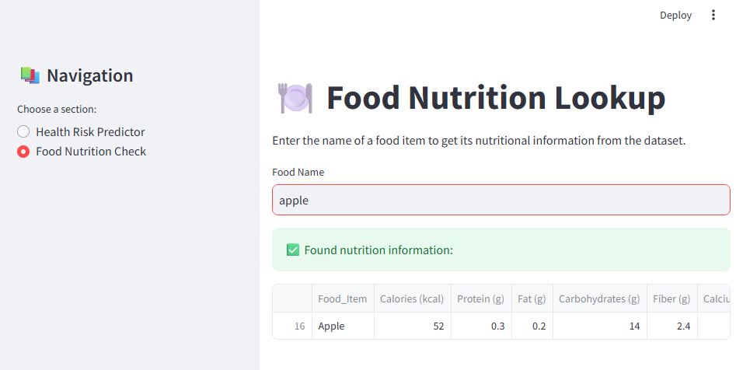
User Interface
Sidebar for navigation.
Two main pages:
Health Risk Predictor (input + prediction)
Food Nutrition Check (lookup)
Nutrient graphs created with Matplotlib.
The interface is designed for ease of use and clarity.

Slide 12
Results
Achieved high accuracy in disease risk prediction using :
Decision Tree: 0.9991 (Highest Accuracy)
Random Forest: 0.9971
Voting Classifier: 0.9618
Support Vector Machine: 0.9235
Successfully visualized nutrient data with charts
Demonstrated practical use case with user-friendly interface

Slide 13
Conclusion
The system effectively combines nutrition tracking with predictive analytics:
Helps users monitor their diet
Predicts diseases based on nutritional patterns
Provides a practical tool for preventive healthcare

Slide 14
Future Scope
Integrate wearable devices (Fitbit, Apple Watch)
Add meal suggestions based on deficiencies
Include diet plans and progress tracking
Expand to Android/iOS for better accessibility

Slide 15
Thank You

